Slide 1
Design and Development of Automatic Intelligent Locking System with Real Time SMS Notifications

Slide 2
CONTENTS
INTRODUCTION
OBJECTIVES
BLOCK DIAGRAM
FLOW CHART
REQUIRED COMPONENTS
OVERVIEW OF 89C52
OVERVIEW OF GSM 900
OVERVIEW OF KEYPAD
OVERVIEW OF LCD
CIRCUIT DIAGRAM
WORKING PROCEDURE
APPLICATIONS
FUTURE PROSPECTS
CONCLUSION
REFERENCES

Slide 3
INTRODUCTION
In the present era security is a great concern for everybody; starting from individuals to banks to any business or government organizations. This system can serve to address this issue of security to a large extent. This would ensure that unauthorized access to secured areas or information is prevented. This System will provide access upon correct password while ensuring that proper security alerts are triggered upon any unauthorized access trials. Not only that, this system will send you notifications to your cellular phone for all the events happing in the system and will capture the images of the persons. Once the system goes into Lock-Down state, can be unlocked by owner’s phone by a unique unlock code.

Slide 4
OBJECTIVES
The user will enter the password through a keypad.
If the correct password is entered,
The door opens.
The current status will be displayed on the LCD.
A notification will be sent to the owner’s phone.
If the entered password is wrong,
A warning bulb glows.
The LCD will display the warning status.
A notification will be sent to the owner’s phone.
If the wrong password is entered thrice,
The buzzer will be activated and system will be in locked-down state.
A notification will be sent to the owner’s phone.
The owner has to unlock the system through phone.
If the system code is changed, the owner will be informed with the new code.
The camera module will monitor the activities of the system.

Slide 5
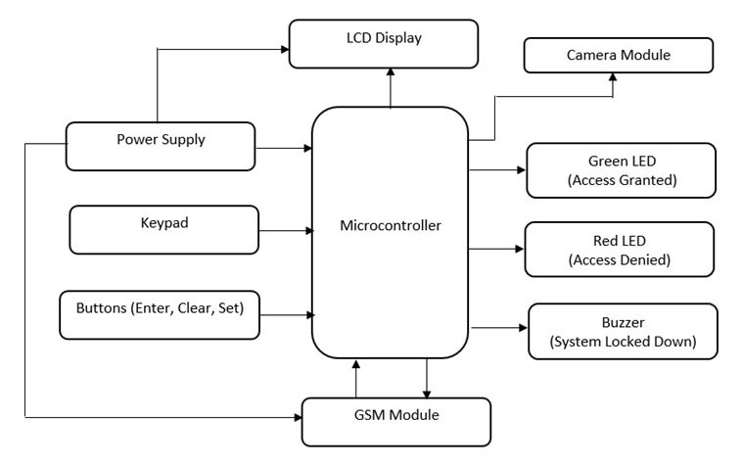
BLOCK DIAGRAM

Slide 6
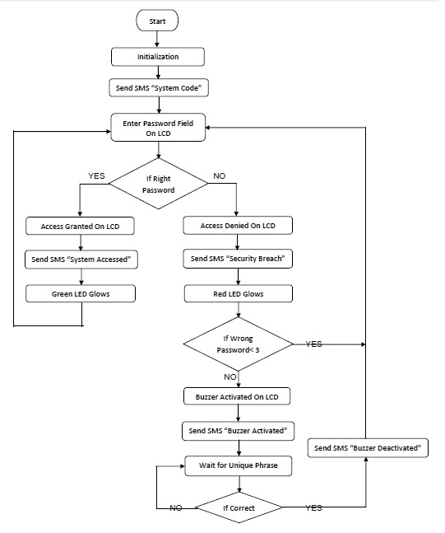
FLOW CHART

Slide 7
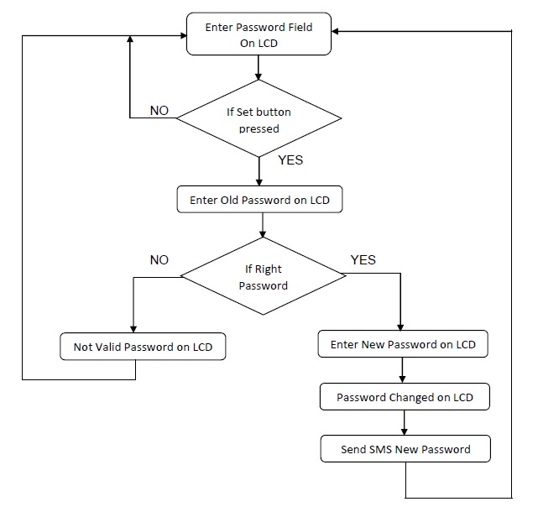

Slide 8
REQUIRED COMPONENTS
GSM SIM900 Module
89C52 Microcontroller, Crystal Oscillator(11.0592MHz)
Matrix Keypad, Push Button
Liquid Crystal Display or LCD (16x2)
Door Status Indicator--- LEDs (Green, Red), Buzzer
IC Programmer (VP812), Keil C Software, Proteus Software
Associated Resistors, Capacitors.

Slide 9
AN OVERVIEW OF 89C52 µC
8K Bytes of Reprogrammable Flash Memory
256 x 8-bit Internal RAM
Clock Speed: 0 Hz to 24 MHz
32 Programmable I/O Lines
Three 16-bit Timer/Counters
Eight Interrupt Sources
Programmable Serial Channel (UART)
Endurance: 1,000 Write/Erase Cycles
Three-level Program Memory Lock
Low-power Idle and Power-down Modes

Slide 10
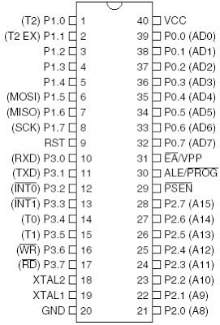
PIN DIAGRAM OF 89C52 µC

Slide 11
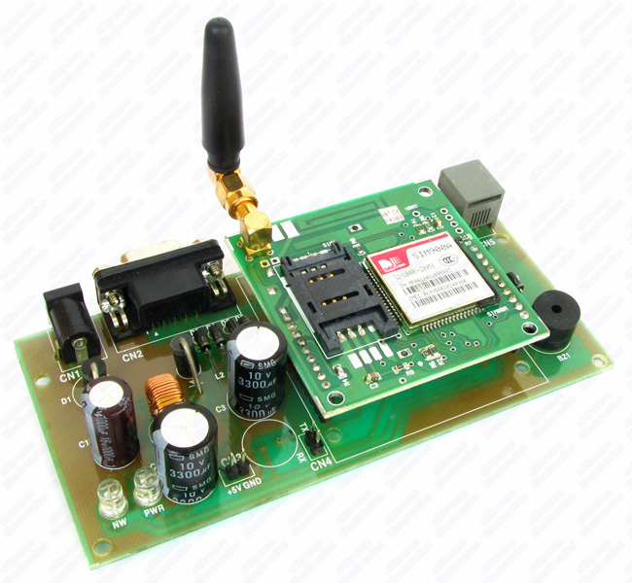
AN OVERVIEW OF GSM SIM900
Quad-Band 850/ 900/ 1800/ 1900 MHz
Control via AT commands
Provides standard serial RS232
interface
Onboard MIC and Speaker
adjustable serial baud rate from
1200 to 115200 bps

Slide 12
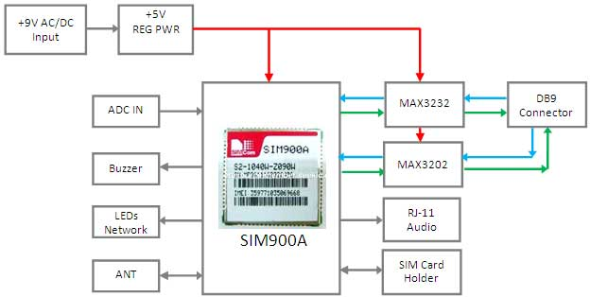
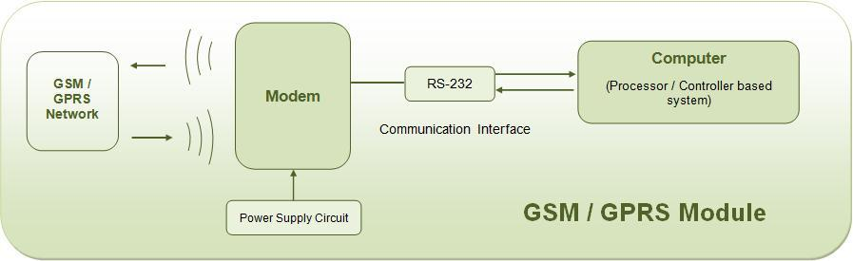
AN OVERVIEW OF GSM 900

Slide 13
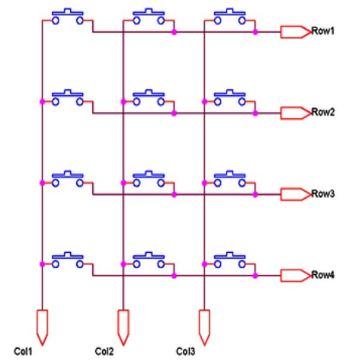
AN OVERVIEW OF KEYPAD
Reduces microcontroller pins
Column and row pins are connected to the
inputs and output pins respectively.
Normally column pins are pulled up.
A logic LOW is given to Row1 .
Row2 – Row4 HIGH.
Each Column is scanned.
If any switch belongs to 1 row
is pressed corresponding column will
pulled down .
This process is repeated for all rows.

Slide 14
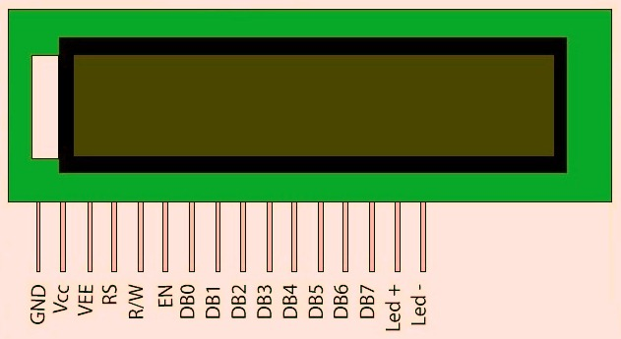
AN OVERVIEW OF LCD
16X2 LCD Display
HD44780U dot-matrix liquid crystal display Controller.
5 x 7 and 5 x 10 dot matrix possible
4-bit or 8-bit MPU interface enabled
208 character fonts (5 x7 dot)
32 character fonts (5 x10 dot)
Internal oscillator with external
resistors.
Low power consumption(2.7-5.5V)

Slide 15
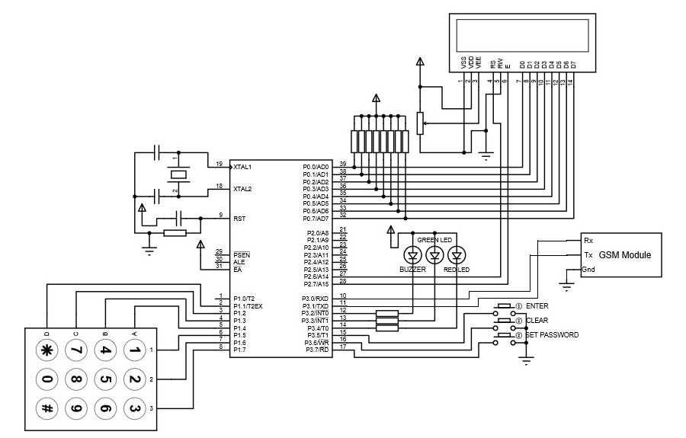
CIRCUIT DIAGRAM
LCD Display
Microcontroller
Indicators
GSM Module
4X3 Keypad
Buttons

Slide 16
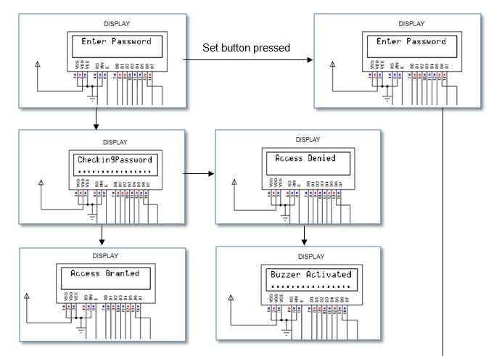
WORKING PROCEDURE

Slide 17
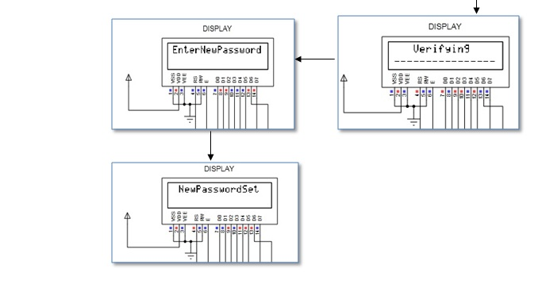

Slide 18
APPLICATIONS
Home Security
Banking locker facilities
Industrial facilities
Commercial buildings
Government and military
Museums and Art galleries, Ware houses
Long term care facilities

Slide 19
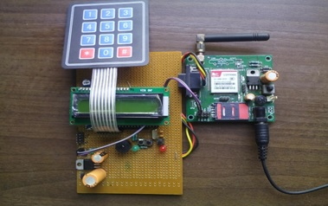
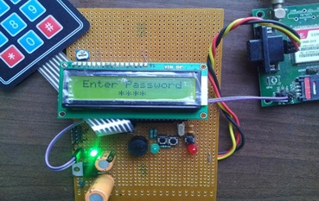
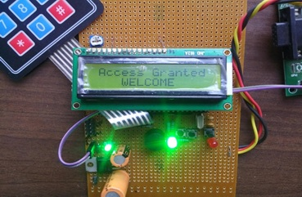
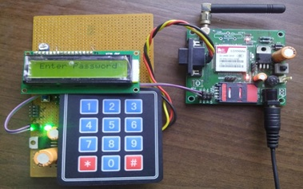
HARDWARE

Slide 20
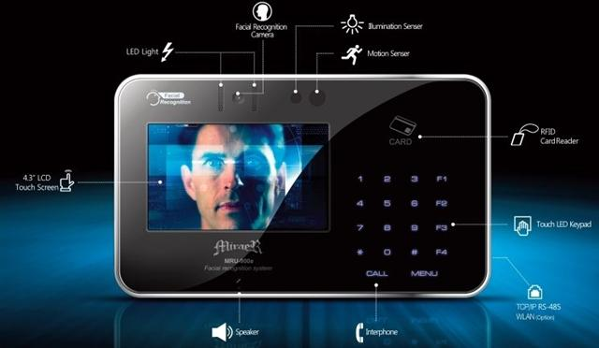
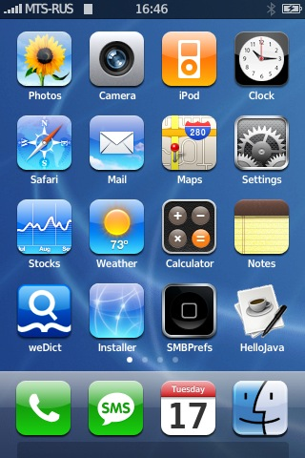

FUTURE PROSPECTS
Application
Software
The Smartphone and
Security System Combination
Facial Recognition

Slide 21
CONCLUSION
This project has the potential to be utilized in the real world where security is a prime concern for every individual and organization. This project can be implemented for home security, industrial, or for that matter in any organization.
This locking system can be used to prevent any sort of unauthorized access to secured areas or information. It can help combat crime to an extent. This project keeps the possibility open for adding additional features to improve its performance and security support potentials.

Slide 22
REFERENCES
89C52 Datasheet with Instruction Set:
http://www.atmel.com/images/doc0313.pdf
16x2 LCD Datasheet:
https://www.sparkfun.com/datasheets/LCD/ADM1602K-NSW-FBS-3.3v.pdf
16x2 LCD Controller (HD44780U): http://fab.cba.mit.edu/classes/863.06/11.13/44780.pdf
4x3 Matrix Keypad:
http://microforbetterlive.blogspot.in/2009/05/access-4x3-keypad.html
SIM900:
http://probots.co.in/Manuals/SIM900%20GSM%20Modem%20-%20Starter%20Guide.pdf
SIM900 AT Commands Manual: www.propox.com/download/docs/SIM900_AT.pdf

Slide 23
THANK YOU

